Slide 1


Hispanic Achievers Florida Plate
&
500th Florida Discovery www.hispanicachievers.com
Dennis Freytes: Chairman Hispanic Achievers Grant Council
Lisa Pietri: Hispanic Achievers Florida Plate Administrator
22 March 2012 (U)

Slide 2
Agenda
A. OPEN: Introductions; Opening Comments
B. DISCUSS:
1. Hispanic Achievers Florida Plate/ Grant Council:
a. Background, Overview, Organization
b. Support & Promote.
2. 500th Florida Discovery Council; Celebrations/ Events
a. FL Discovery Summary History/ Ponce de Leon
b. Viva Florida 500 (FL Secretary of State Partners);
c. Aim, Focus, Calendar of Events
d. UTB-Royal Order Ponce de Leon/ Landing Event (2 April 2013);
Ponce de Leon Island/ Statute
C. Questions & Comments???
D. CLOSE: Summary

Slide 3
BACKGROUND
Hispanic Achievers Florida Plate/ Grant Council
Motto: “Since 1513 Hispanics serve Florida-making Communities prosper!”
“Florida salutes/ recognizes American Hispanic Achievers”-- with the
1st national historic American Hispanic Achievers License Plate-- for their valuable contributions to Florida...; provides funding focused on helping Communities, and for Scholarships, through Non-Profits…
1. Initiative of Danny Ramos (Chairman/ CEO of NHCA-National Hispanic
Corporate Achievers), and Jay Rosario (Nissan Dealer);
2. Bill by: Speaker Cannon and Sen. Siplin; signed: FL Gov. Crist.
3. First HAFL Plate Administrator is Lisa Pietri. (NHCA South President)
4. First HAGC Chairman/Organizer is Dennis Freytes (Lt. Colonel, US Army Ret.; Community Servant).
“The more Plates sold—the more GRANTS to help Communities!”

Slide 4
Hispanic Achievers’ Grant Council-
Florida Plate
Aim/ Focus: Recognize, and honor the contributions of American
Hispanics to Florida, USA; support good Community Programs and
Scholarships… (Funds: 90% for Grants; 10% Adm.)
Mission:
(1) promote and market the Florida Hispanic Achievers’ License Plate
(FHALP);
(2) develop other revenue streams/ contributions for Community
programs (that focus on American Hispanics);
(3) evaluate and transparently provide grants to qualified Non-Profits
and for scholarships;
(4) serve as Ambassadors of unity/ good will to all American Floridians;
(5) properly operate under/per the Florida Law…
Please, help promote or Sponsor; more Plates sold—more Grants!

Slide 5
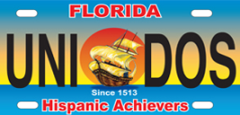
Macro-Goals
Dynamically market and promote the Florida HA License Plate, and the HAGC-- to tap into all revenue streams/ contributions that will raise more grants to fund more programs for American Hispanics.
Conduct effective, efficient, and compassionate service, properly: (1) review grant proposals; (2) select Non-Profits/Individuals for evaluation; (3) make site evaluation visits; (4) transparently award grants/scholarships, per the Operating Procedures.
Ethically serve our Communities & Florida, focusing on Hispanic worthwhile needs.
Communicate with Florida Corporate Partners, Government Community/ Small Business Leaders, and Others; educate and raise awareness of the good intent of Grant funds; elicit support; work together for the good of all.

Slide 6
*Circle of Senior Counsels:
Merci McCall (C), Jay Rosario (C),
Rep. Darren Soto, Com. John Quinones, Com. Art Otero, Com. Wanda Rentas, Com. Cortes, TBD
*Special Supporters: FL Gov. Scott; PR Gov. Fortuno, Speaker Dean Cannon,
Sen. Siplin, PR Sec of State McClinctock…
*Special Advisors: Arminda Figueroa, Evelyn Ramirez, Tirso Moreno, Zoraida Rios, Elias R. Piccard, TBD
*Noble Volunteers: TBP
*MAGNUM Sponsors: TBD
*GOLD Sponsors: TBD
*SILVER Sponsors: TBD
*BRONZE Sponsors: TBD
National Hispanic CA
*NHCA Board/Chair
*CEO/ *HAFLP ADM
HAGC TEAM
*Chairman
*Co-Chairman
* Plans/ Opns/ Eval.
Committee
North Region
Chair
Central Region Chair
South Region
Chair
HR/Adm/ Log.
Committee
+ Secretary
(*Ex. ADM)
Finance & Efficiency Committee
Marketing
Committee/ Advs. & Vols.
Legal ADV. Committee/
ADV/VOLs
Area /CTY Chairs
Area/CTY Chairs
Efficiency Committee ADV/VOLs
Promotion
Committee
ADV/VOLs
Area/CTY
Chairs
Adm. & Log. Committee
ADV/VOLs
North Eval. Team
Cent. Eval. Team
South Eval. Team
PA/Media Committee Advs. & Vols.
Gov. Affairs Committee
Advs. & Vols.
Business/ Sponsors Committee Advs. & Vols.
Community Affairs /Events Committee Advs. & Vols.
Education/
Training Committee
Advs. & Vols.
GALA/Events
Committee
Advs. & Vols.
Ad-Hoc Committees
Advs. & Vols.

Slide 7
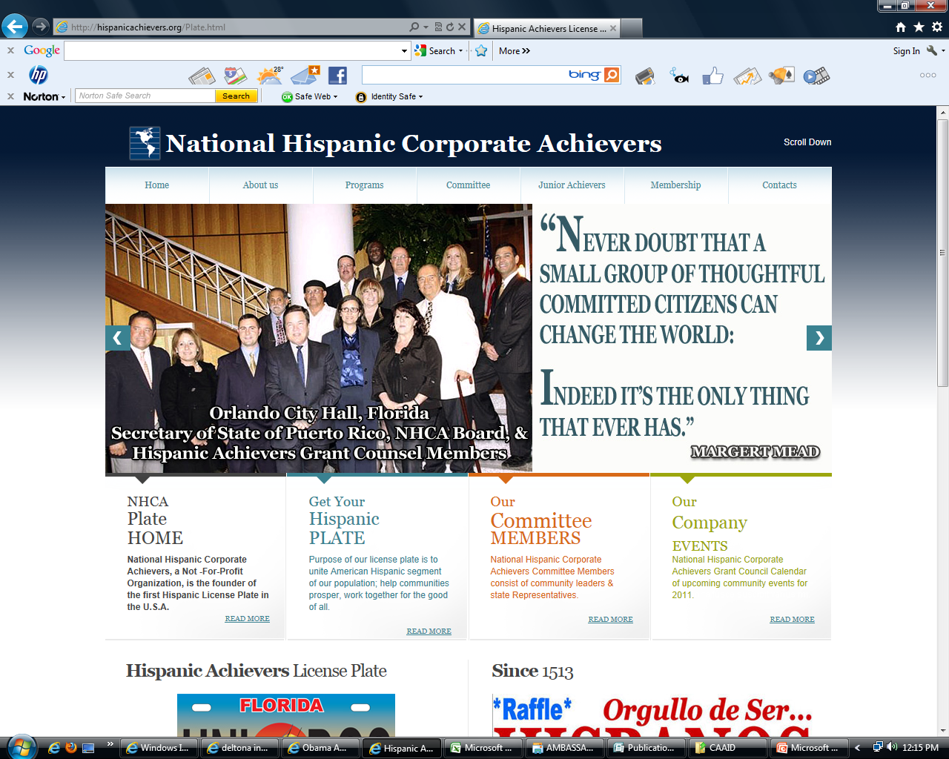

Slide 8
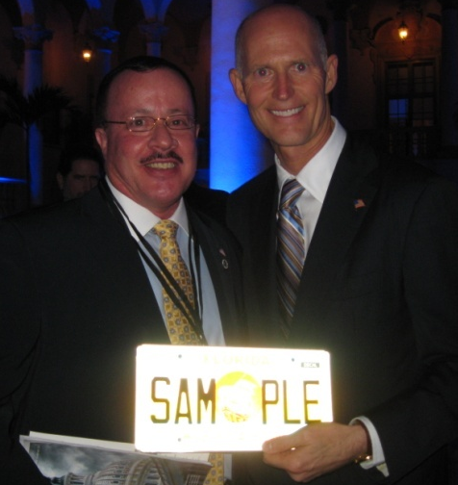
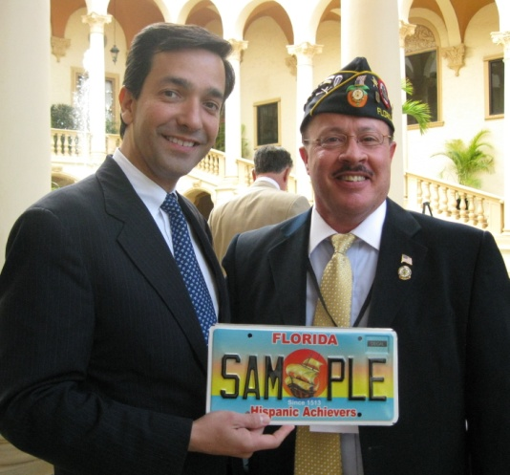
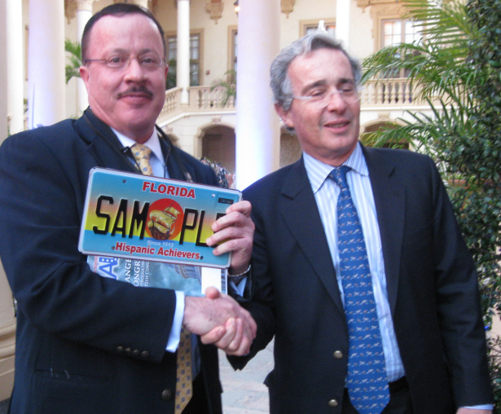
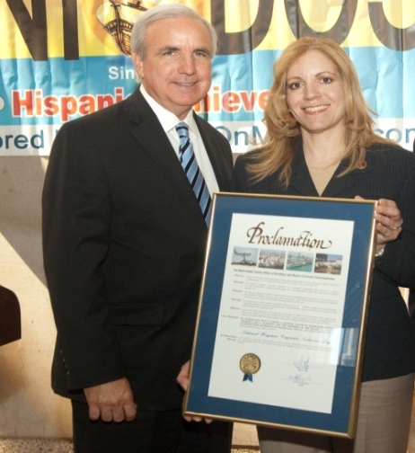
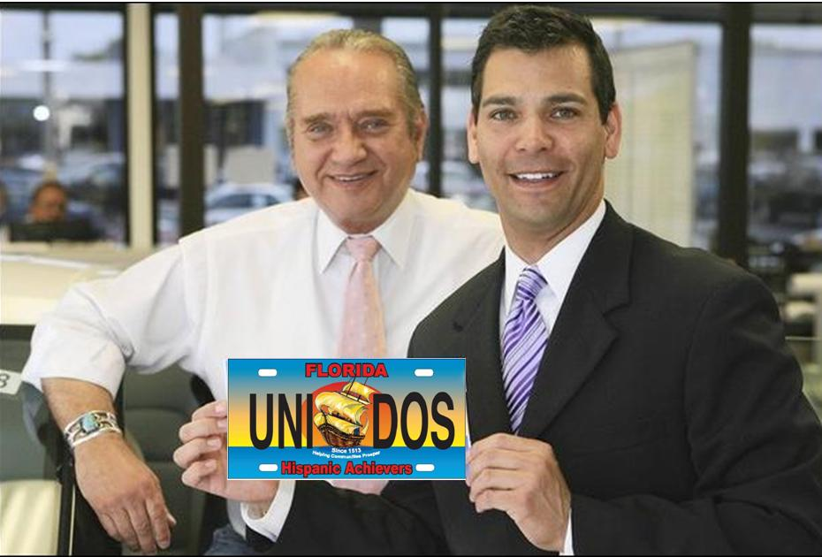
Hispanic Achievers Plate Supporters

Slide 9
FL Discovery History
Juan Ponce de León, 1st Governor of Puerto Rico organized an expedition and with his Crew (including free Blacks, Women…) set sail, in March 1513, from the now US Territory of Puerto Rico-- in search of the legendary island of Bimini…
*In the Spring of 1513 (April 2), they landed near Melbourne Beach, Brevard County; named it La Florida, after Pascua Florida, the Feast of Flowers or Easter, the season of their discovery…
In 2013--500 years will have passed since these brave European Explorers opened the first door to the European settlement of Florida and of the USA; put Florida on the map…Brought Christianity, horses, cattle, sheep…to America…
These Hispanic Ancestors are part of American Hispanic/ Puerto Rican linage, heritage, roots…history.
Note: Puerto Rico was the gateway to the discovery of Florida-- which opened the first door to the European advance civilized settlement of the USA. (About, 107 years before the Pilgrims landed.)

Slide 10
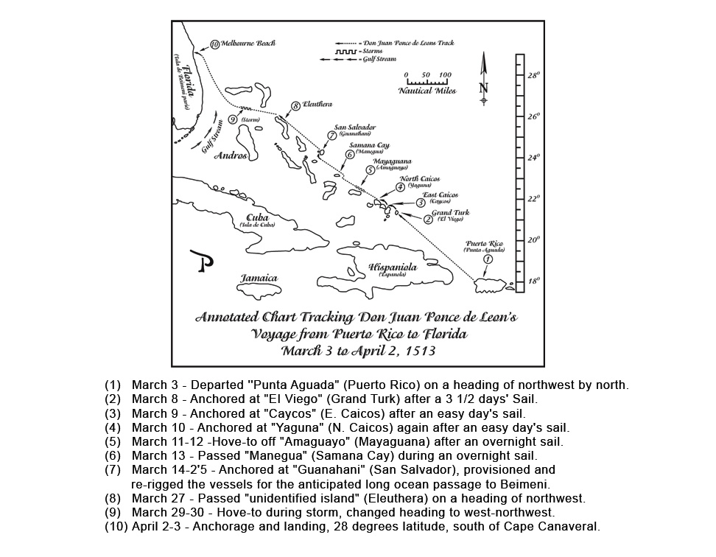

Slide 11
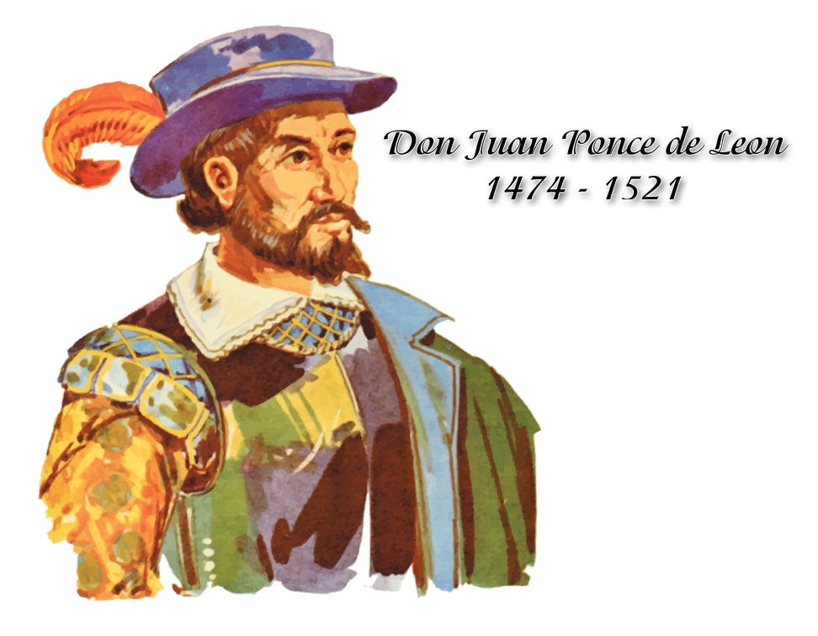
Viva Florida-500
Inclusive Celebrations/ Events
Info./Coordination/Event Web Sites:
www.Fla500.com
www.vivaflorida.org
Supported by: Florida Secretary of State; FL Governor; FL Humanities Council; Partner Organizations…

Slide 12
500th FL Discovery Council
Aim:
Serve as an umbrella round table Council; bring Leaders/Organizations together to commemorate the 500 years of the European Florida discovery;
Forge Citizen-Community-Government Partnerships
Highlight all contributions in the forming of Florida–which opened the doors to the advanced civilized settlement of the USA (107 years before the Pilgrims);
Develop PAC-A MEMOS (Planning & Coordination- Action)/ Promote: Magna Events with Florida Discovery themes; honor all Ancestors/ Roots—include American Hispanics; Blacks, Asian, Natives…;
Involve all to include our youth, students, children…

Slide 13
500th FL Disc. Council
FOCUS
Bring goodwill, business, tourism, inter-exchanges (social, cultural, religious, other); historic understanding, … through inclusive Partners’ discovery magna events;
Spark the entrepreneurial spirit; business opportunities…
Coordinate Major Events: Educational Seminars, International Business Expo/Trade Missions; Gala Dinners, Parades, Festivals, Museum Exhibits, Non-Denomination Religious Services…

Slide 14
CF Discovery Organization
Honorary Chairs: Osceola Chairman John Quinones; Others: TBP
Honorary Vice- Chairs: Dr. Jenkins (OCPS); Rep. Soto, Com. Cortes (Longwood); VC Melendez (Osceola Schools); Com. Ortiz (Orlando), Com. Rentas (Kissimmee); Samuel Lopez (UTB); R. Ojeda (Pres. HCC); Others: TBD
Special FL Discovery Supporters include:
FL Sen. Rubio, Gov. (FL & PR), Sec. of State (FL & PR); Orange County, Orlando/other Mayors; OC Sheriff; OCP Schools; Valencia College…
Council PAC-A Commitees: TBD
Organization Internal PAC-ACommittees

Slide 15
Master Calendar of Events
Date/Time; Event; Location; POC: TBD
Partners/Committees: Please--
Develop PAC-A Plans
Send Calendar of Events, Time Lines, Support Info… to all.
Some Calendar of Events follow: TBP

Slide 16
Major Events Overview
Education Symposium/Seminars (CF): Plan for 2012 (Oct or Nov.; Partner with Viva Florida-500 (FL Sec. of State) and Others.
Discovery International Business Expo (2013 April or?): Hispanic/PR/Other Chambers…
Parade/ Festival
Museum/ Art Exhibits/ Re-Creation Plays
Other: Gala Lunches, Dinners, Religious Services…

Slide 17
Overview Projects/ Other
1. Ponce de Leon Island Naming: Being considered by US Board Geographic Names (US Interior Department); strong letters of support are promptly needed for approval.
2. Statute Ponce de Leon (Brevard/Melbourne Beach): Need Sponsors; Contributors… (UTB-Royal Order Ponce de Leon)
3. Disney, Universal, Sea World, Other involvemen: Promote discovery themes (2013); Special Discovery Passes; parade?
4. Resolutions, Proclamations, Letters of Support: (See Drafts—enclosed in PAC Memo/ Emails)
5. Inter-exchanges between: FL, PR, Spain, France, Great Britain, Latin American, and other Countries.
6. MEDIA
Promote, Support, Sponsor! PAC-A!

Slide 18
UTB-Royal Order Ponce de Leon
Support Name: Ponce de Leon Island (Brevard County)
Support Build: Ponce de Leon Statue
Magna Landing Celebrations- 2 APR 2013 (Melbourne Beach)—Tall Ships, Jet Fly Over, Parachute Jumps, 21 Gun Salute, Royal Mass…)
Brevard Invitees Include: King & Queen of Spain;
POTUS, Governors, Mayors…
(*NOTE: Invite to Central FL Activities…)
Other Events: Royal Mass/ Gala Lunch/ Dinner, Parade, Festival…

Slide 19
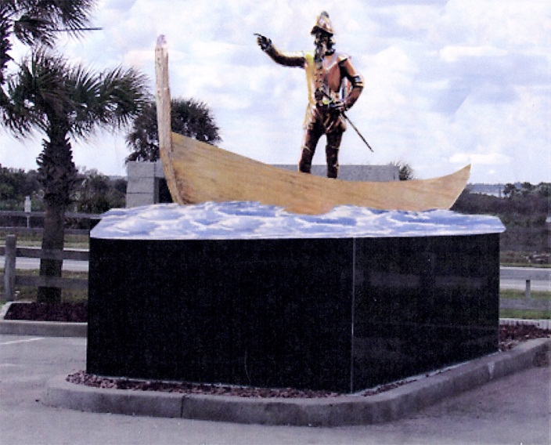
Ponce de Leon Park
Highway A1A, 4005 Melbourne Beach
On SR-A1A 6.2 miles south of US-192
Open after 7:00 a.m. until dark, except for scheduled use.
This 25.57-acre regional beach park features 2 beach crossovers, a small pavilion, restrooms, and parking.
ADA ACCESSIBLE: Parking & Restrooms
ACTIVITY FEATURES: Swimming, Fishing & Picnics

Slide 20


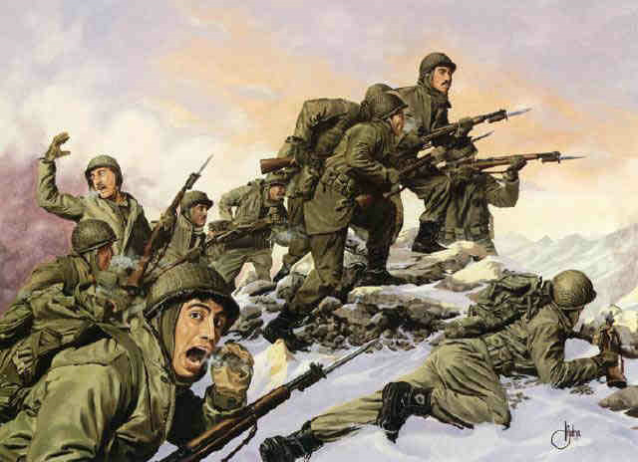

U.S. 65th Infantry Regiment from Puerto Rico

Slide 21
QUESTIONS???//COMMENTS???
Get PLATE/ Support Community: www.hispanicachievers.org
Lisa Pietri (HA Florida Plate Adm.): 321-277-0850; hadiversity@bellsouth.net
Dennis Freytes (HAGC-Chairman): 407-298-1151; dennisfreytes@hotmail.com
“No Task too difficult; No Mission impossible-Will do!”
AmerI-CAN!

Slide 22
In Closing
Be A Partner (“Knight/Lady”) of Good!
Take on a courageous and glorious quest!
Dream the impossible dream;
Right the un-rightable wrong;
Fight for the right without question or pause;
March into Hell for a heavenly cause…
Run where the brave dare not go;
Make the World better for this; reach the unreachable Star! Make it happen!

Slide 23

Closing
Summary
THANKS!
“Lets work together for the good of all: Family, Community, Florida, USA, and Humanity!”

